Slide 1
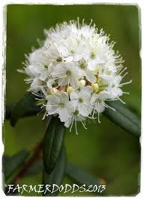
LEDUM PALUSTRE

Slide 2
Ledum Palustre, also known as Marsh Tea or Wild Rosemary, is a flowering evergreen shrub that grows to a height of 1 metre.

Slide 4
COMMON NAME : Marsh tea
FAMILY : Ericaceae
PROVER : Dr Hahnemann

Slide 5
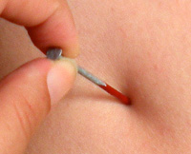
CLINICAL USES:
Past uses have been in the treatment of puncture wounds produced by sharp pointed instrument.

Slide 6
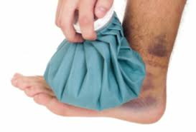
Homeopathically, Ledum is used for insect bites, and cold swellings or bruises which feel much better for ice-cold applications.

Slide 7
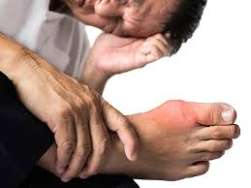
CONSTITUTION AND ADAPTABILITY
Adapted to rheumatic, gouty diathesis.
Rheumatism begins in feet and travels upward.

Slide 8
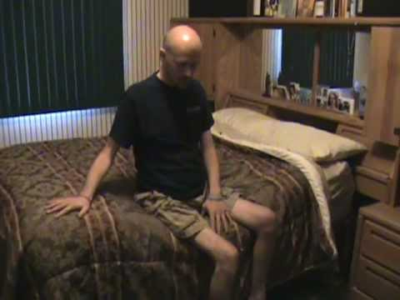
Ledum affects the skin, producing an eruption like poison-oak.
The heat of bed is intolerable.

Slide 9
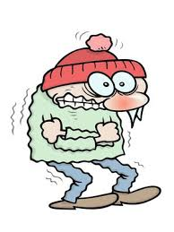
Wounded parts are especially cold to touch.
Always feel cold and chilly

Slide 10
MIND
Desire for solitude.
After nightmare, fears to go to sleep
Inclined to be angry ; vehement (showing strong feeling )
Dissatisfied ; hates his fellow-beings.

Slide 11
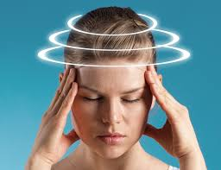
HEAD
Vertigo when walking, with tendency to fall to one side.
Distress when head is covered.
Eruption and creeping sensation on the scalp.

Slide 12
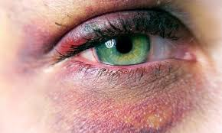
EYES
The eyes are inflamed, the lids are agglutinated, and febrile movements occur in the evenings.
Contused wounds
Cataract with gout

Slide 13
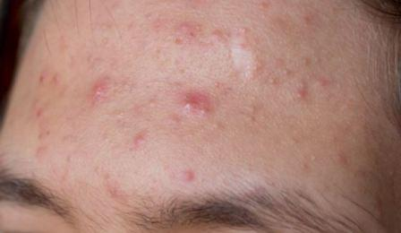
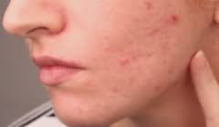
FACE
Red pimples on forehead and cheek
Crusty eruption around nose and mouth

Slide 14
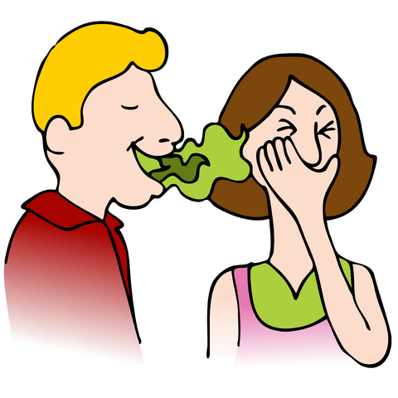
MOUTH
Offensive breath.
Sudden running of water-like saliva from mouth, with colic ; waterbrash.

Slide 15
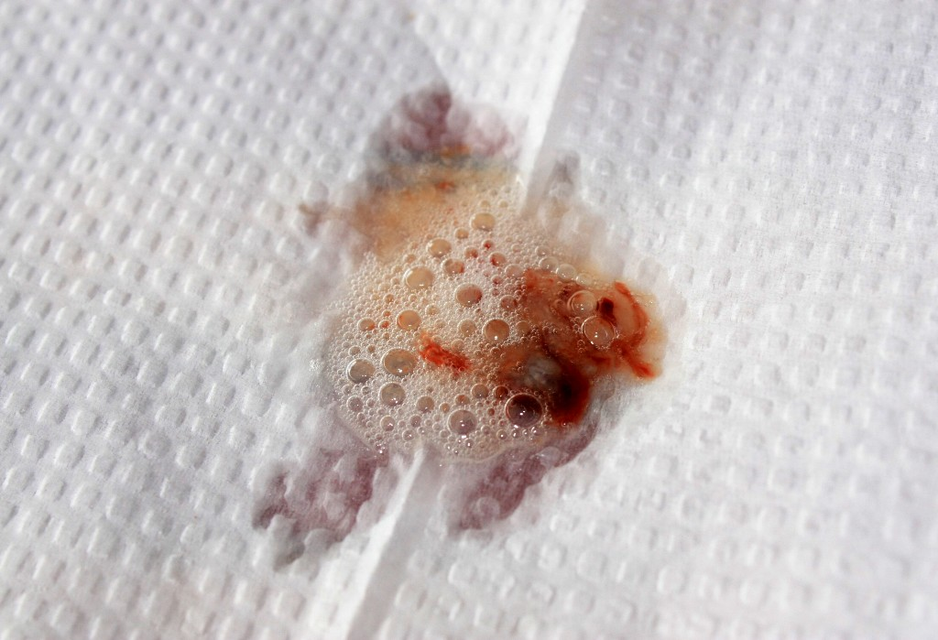
RESPIRATORY COMPLAINTS
Burning in nose.
Cough, with bloody expectoration.
Dyspnœa; chest feels constricted. Suffocative arrest of breathing.
Pain along trachea.

Slide 16
Bronchitis with emphysema of aged.
Oppressive constriction of chest.
Tickling in larynx; spasmodic cough.

Slide 17
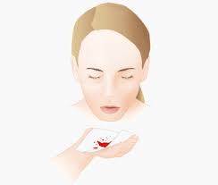
Hæmoptysis, alternating with rheumatism.
Whooping-cough; spasmodic, double inspiration with sobbing.

Slide 18
EXTREMITIES
Throbbing in rt shoulder
Gouty nodosities.
Rheumatism begins in lower limbs and ascends.

Slide 19
MALE
violent and prolonged erections.
Inflammatory swelling of penis.
Increased sexual desire.

Slide 20
FEMALE
Catamenia too early and too copious; the blood is bright red.

Slide 21
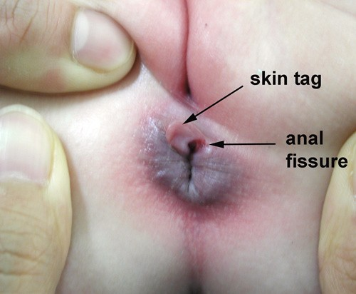
RECTUM
Anal fissures
Haemorrhoidal pain

Slide 22
INJURIES
Punctured wounds by sharp pointed instruments such as nails, rat bites, stings of insects esp mosquitoes.
Long remaining discolouration after injuries, black and blue places become green.

Slide 23
MODALITIES
Better from cold, putting feet in cold water.
Worse at night from heat of bed.

Slide 24
RELATIONSHIP
Compare: Ruta, Ham,Bellis, Arn.

